Slide 1
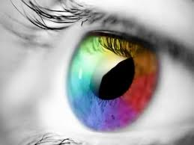
Sense of Vision

Slide 2
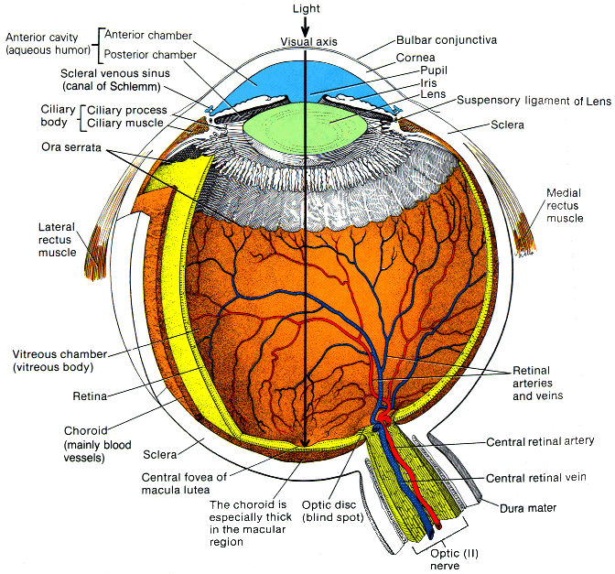
Introduction
Main Organ
Eye
Accessory Organs
Eyelids
Lacrimal apparatus
Extrinsic muscles

Slide 3
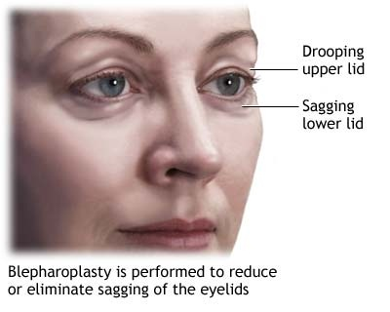
Visual Accessory Organs
Housed in orbital cavity of skull
Eyelid
Four layers
Skin
Thinnest on body
Covers the lids outer surface and fuses with its inner lining near the margin of the lid
Muscle
Orbicularis oculi-closes lid
Levator palpebrae superioris raises upper lid, keeps eye open
Connective tissue
Conjunctiva
Mucous membrane that lines the inner surfaces of eyelid and folds back to cover the anterior surface of eyeball

Slide 4
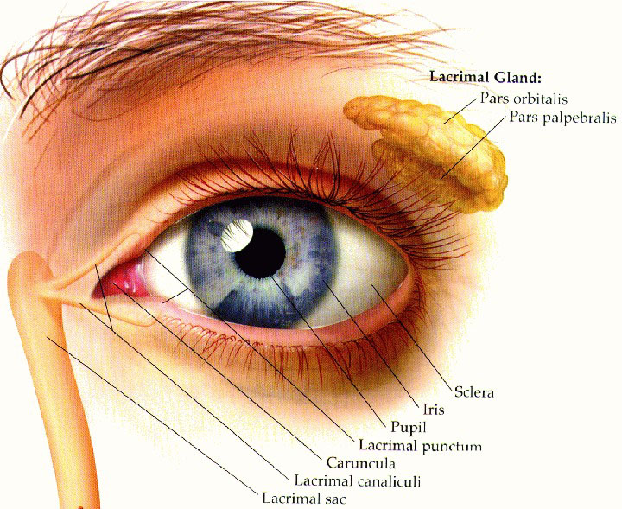
Lacrimal appratus
Consists of:
Lacrimal gland
Located in the orbit
Secretes tears continuously
Tears contain enzyme lysozyme that kills bacteria
Moistens and lubricates the surface of eye and the lining of the lids
Series of Ducts
Superior and Inferior Canaliculi
Collect tears that are flowing to lacrimal sac
Nasolacrimal duct
Carries tears into the nasal cavity

Slide 5
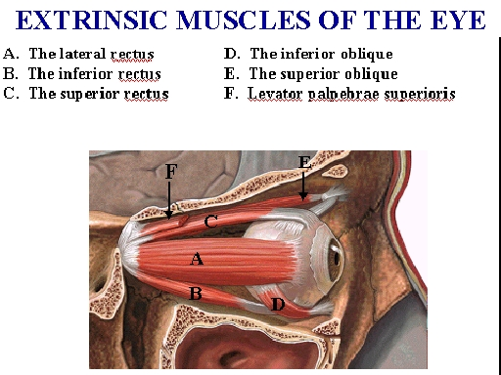
Extrinsic Muscles
6 muscles move the eye in various directions
Each one has a primary action but many are used with each eye movement
Table 10.2 lists functions of extrinsic muscles

Slide 6
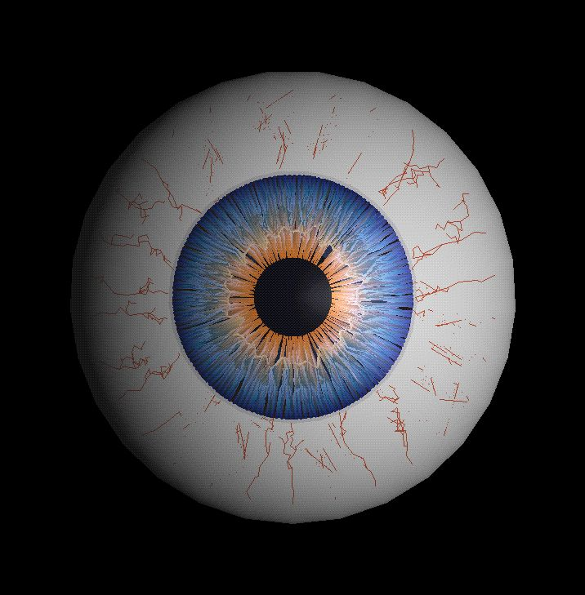
Structure of the Eye
Hollow, spherical structure
Approx. 2.5 cm in diameter
3 distinct layers
Outer (fibrous) layer
Middle (vascular) layer
Inner (nervous) layer
Spaces within eye filled with fluid

Slide 7
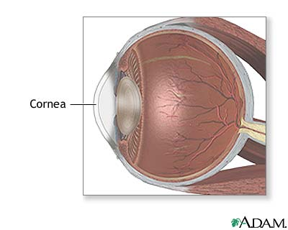
Outer Layer
Cornea
Anterior 1/6th of the outer layer
Transparent and bulges forward
Transparent because it contains few cells and no blood vessels
Window of eye
Helps focus entering light rays
Composed largely of connective tissue with a thin surface layer of epithelium

Slide 8
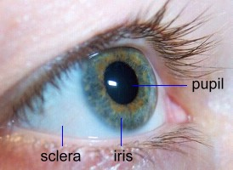
Outer Layer Cont.
Sclera
Along circumference of cornea
White portion
Makes up posterior 5/6ths of outer layer
Opaque due to many large, disorganized, collagenous and elastic fibers
Protects eye and provides attachment for extrinsic muscles
Optic Nerve attaches to back of sclera
Certain blood vessels pierce sclera

Slide 9
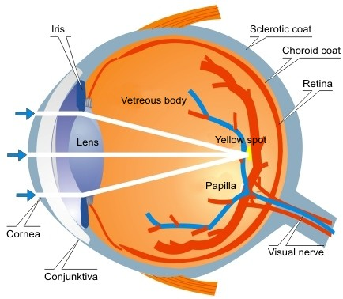
Middle Layer
Choroid Coat
Posterior 5/6ths of globe of eye
Loosely joined to sclera
Honeycombed with blood vessels
Contains pigment-producing melanocytes
Melanin produced helps absorb excess sunlight which helps keep inside of eye dark

Slide 10
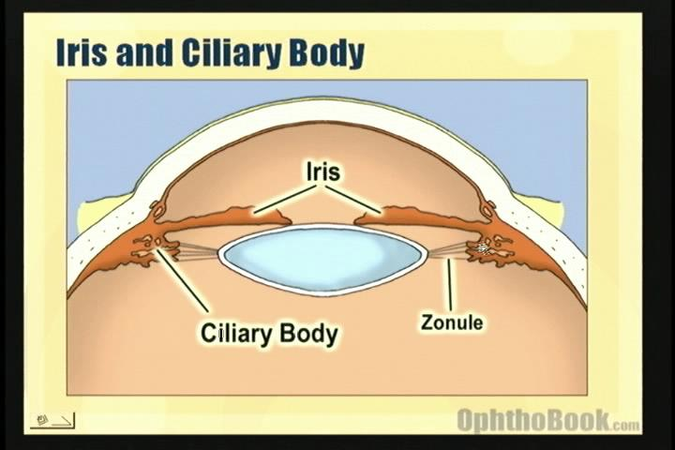
Middle Layer Cont.
Ciliary Body
Thickest part of middle layer
Extends forward from choroid coat and forms internal ring around the front of eye
Contains many folds called ciliary processes and groups of muscle fibers called ciliary muscles

Slide 11
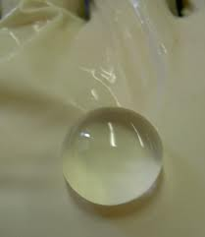
Middle Layer Cont.
Lens
Held in position by strong, delicate fibers called suspensory ligaments that extend inward from the ciliary processes
Transparent
Lies directly behind the iris and pupil
Composed of highly specialized epithelial cells called lens fibers

Slide 12
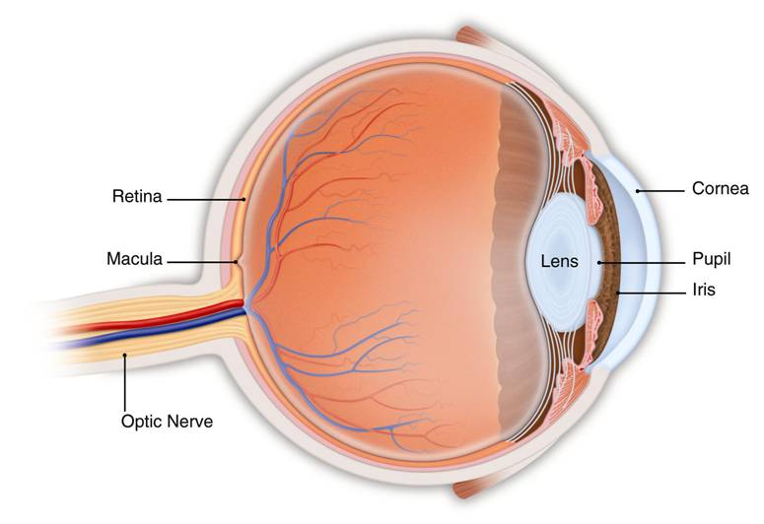
Lens Cont.
Easily adjusts shape to facilitate focusing
Called accomodation
Enclosed in a clear capsule mostly made up of elastic fibers
Keeps lens under constant tension
When suspensory ligaments pull outward the lens can focus on distant objects
When ligaments relax, you can focus on closer objects

Slide 13
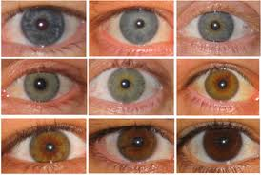
Middle Layer Cont.
Iris
Colored part of eye from the outside
Thin diaphragm composed mostly of connective tissue and smooth muscle fibers
Lies between cornea and lens

Slide 14
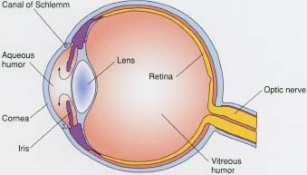
Middle Layer Cont.
Aqueous Humor
Watery fluid secreted by ciliary body
Fills the space between the cornea and lens
Helps nourish cornea and lens
Aids in maintaining eye shape

Slide 15
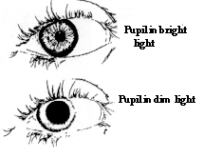
Middle Layer Cont.
Pupil
Circular opening in the center of the iris where light passes through
Size is controlled by two sets of smooth muscle fibers
Circular set
When this contracts, pupil gets smaller, less light enters
Stimulated by bright light, functions to decrease the intensity of light entering eye
Radial set
Diameter of pupil increases with contraction causing more light to enter
Dim light stimulates radial set

Slide 16
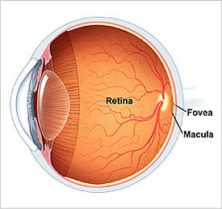
Inner Layer
Retina
Contains the visual receptor cells (photoreceptors)
Nearly transparent
Extends forward from the back of the eye, stopping right behind the ciliary body
Thin and delicate but quite complex
Central region contains a yellowish spot called macula lutea
Depression in center is called fovea centralis
Region of retina that produces sharpest vision

Slide 17
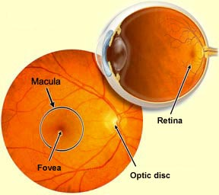
Inner Layer Cont.
Optic Disc
Nerve fibers from retina leave eye and join optic nerve
Central artery and vein pass through
Supply blood to the cells of the inner layer
AKA the blind spot
Lacks photoreceptors

Slide 18
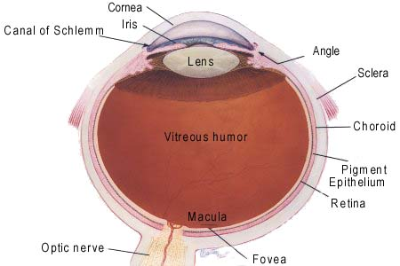
Inner Layer Cont.
Vitreous humor
Jellylike fluid that fills the posterior cavity
Fills the space bound by the lens, ciliary body, and retina (largest compartment)
Helps support the internal parts of eye and maintain shape

Slide 19
Light Refraction
As light waves enter the eye the image is focused on the retina
Focusing bends the light waves
Refraction
As light enters, the convex surface of lens refracts the image and then passes it on to the retina where it gets refracted again.
Works much like a movie screen in the back of the eye with the exception that the image that forms on the retina is upside down and reversed from left to right. Visual cortex must interpret the image in proper position.

Slide 20
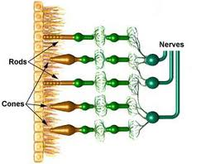
Photoreceptors
Modified neurons with two distinct kinds
Rods
Long thin projections
Provide black and white vision
100 more times sensitive to light than cones
1 type
Cones
Short, blunt projections
Color vision
3 types

Slide 21
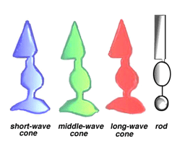
Photoreceptors Cont.
Rods and Cones are located in the deepest part of the retina
Only stimulated when light reaches them
Differ in sharpness of perceived images (visual acuity)
Cones provide sharp images
Rods provide outlines of objects
Due to convergence of nerve fibers (too much traveling on same road)

Slide 22
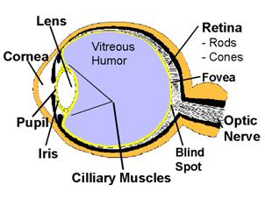
Photoreceptors Cont.
Fovea centralis
Area of sharpest vision lacks Rods but contains many tightly packed cones
Person moves eyes to the important part of image falls on fovea centralis

Slide 23
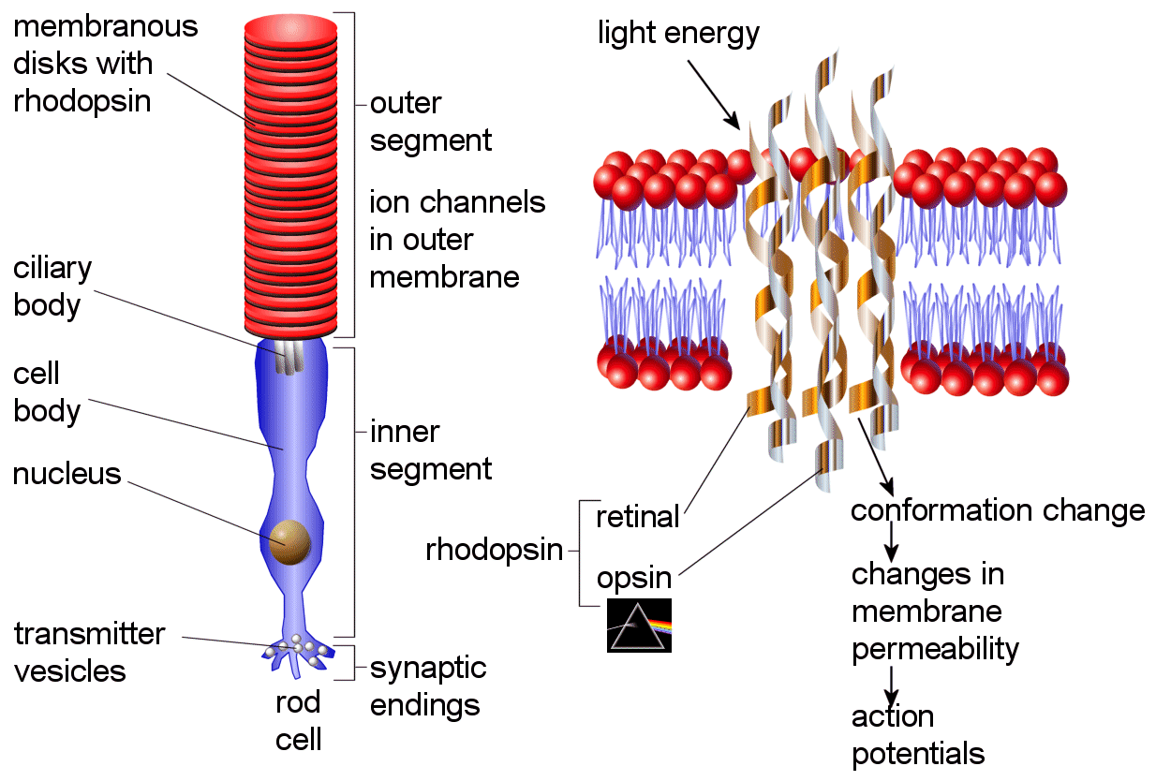
Photopigments
Rods
Contain rhodopsin
Light sensitive biochemical
AKA visual purple
In bright light, rhodopsin decomposes reducing the sensitivity of rods
In dim light, production is regenerated

Slide 24
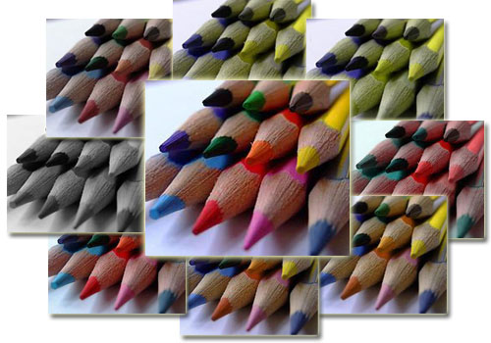
Photopigments Cont.
Cones
Erythrolabe
Most sensitive to red light waves
Chlorolabe
Green light waves
Cyanolabe
Blue Light Waves
Color is dependent on which combination of cones are stimulated
White is all three being stimulated
Black is none being stimulated
Different types of Color blindness occurs with lack of certain cone pigments

Slide 25
Visual Nerve Pathways
Bring impulses from retina to visual cortex
Starts when axons of retinal neurons form optic nerves
Just anterior to pituitary gland nerve form X-shaped (Optic Chiasma) causing some fibers to cross over forming optic tracts
Fibers on medial half of retina cross over, those on lateral (temporal side) don’t
Eventually make it to visual cortex of occipital lobe

Slide 26
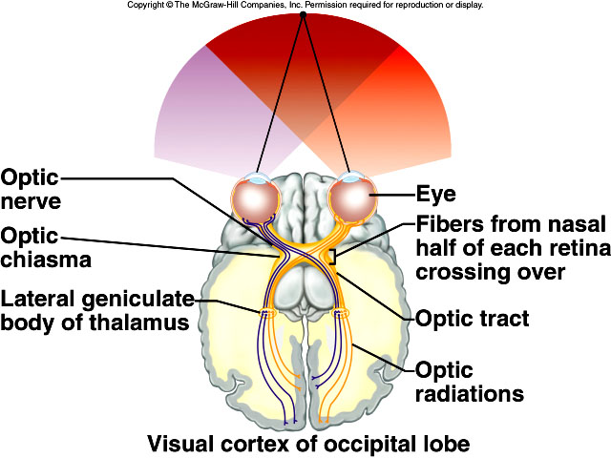
Visual Pathways Figure 10.26

